Slide 1
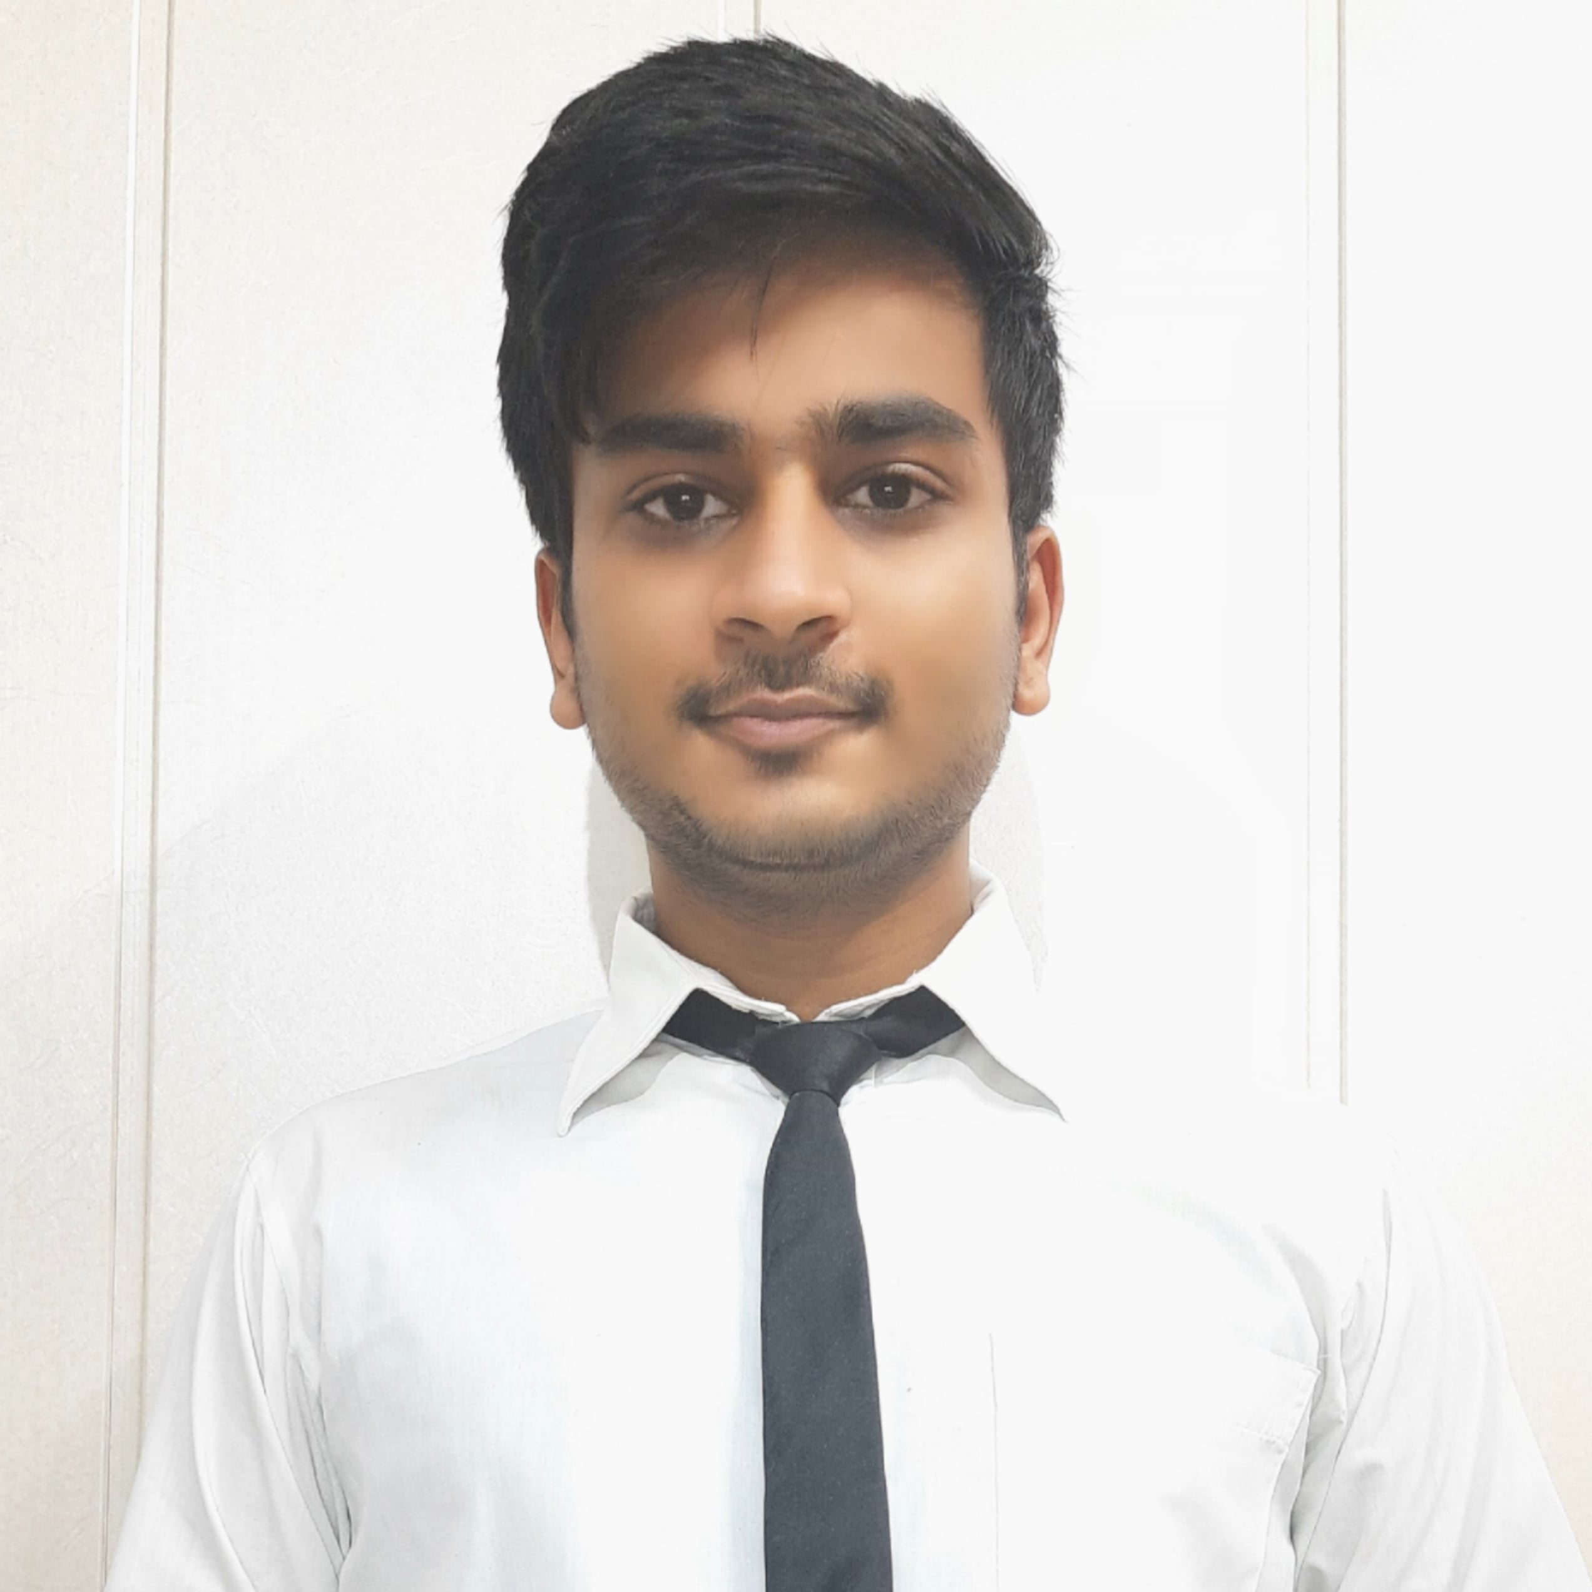



Raghav Gupta
Analyst/Software Engineer
Bachelor of Engineering
Computer Science : 2018 - 2022
Skills
Java 8 /J2EE | Java Basics, OOPS, Generics, Collections, Arrays, Loops, Lambda Exp, Stream API Junit, Exception Handling
Spring core | IOC & Dependency Injection, Autowire
Spring REST | REST controllers, Implementation of GET, POST, PUT & DELETE, Bean Validation & Exception Handling, Testing Services, Controller & Repository layer
Spring Data JPA | Implement DAO layer using spring Data repositories, Transaction Management
Spring Boot Microservices | Microservices Architecture, Spring Boot Starters, annotations, Messaging Service, Swagger API documentation
Spring Cloud | Eureka Server And API Cloud Gateway
React | Components, Hooks, Event handling, axios, Routing
Database | MongoDB No Sql Basics My SQL Basics
UI Tech | HTML 5 & CSS 3, JavaScript, Bootstrap, ReactJs​
Tools | Git, Postman, Maven, IDE
Add On skills | Communications, Team management, Peer learning, Leadership
Bangalore
Kanishk.a.goyal@capgemini.com
+91 7065310557
A4
Full Stack Developer
Hands on experience in creating microservices with Springboot, Spring Security, Spring Cloud API Gateway, Eureka server, Logger.
Proficient in creating Single page Web Application in React with Axios, Routing.
Hands on experience in implementing polygot architecture with Reactjs and SpringBoot.
Experience in creating documentation with swagger and in unit testing using Junit and messaging service using rabbitMQ and email service.
Development experience in creating docker compose files, docker images and pushing to Docker Hub.​
Understanding of AWS Cloud environment
Pharmacy Management Application
Completed end to end case study of Pharmacy Management Application along with JWT authentication, Swagger and payment testing using Paytm, Email service using SMTP,UI with ReactJS used for user interface.​
Traffic Light Management System for emergency vehicles
The project chooses the closest hospital and shortest path to it and turns every traffic light green in which the emergency vehicle is moving for a traffic free route using RF Module, Arduino and GPS.
CAMP TRAINING in Capgemini on JEE with Devops and AWS.
Certifications:
AWS Certified Cloud practitioner
Check out my work on GitHub & Video Profile

